Slide 1
Minimising, Monitoring and tracking Behaviours of Concern
Education Service October 2023
Training for Headteachers and H&S Committees

Slide 2
Objectives
NEW
BECO Coordinator
Minimising BoC through effective Inclusion
BOC Framework
Policy
Resources
Professional Learning
Policy into Practice – Hermitage Park, HT Lisa Black
Management of Incidents
Policy into Practice – St Crispin’s, HT David Fox
Reporting & Follow up
Role of School H&S Committees
Quality Assurance of Inclusion and Incident Management
Governance

Slide 3
Behaviour Coordinator (BECO)
NEW
Member of Senior Leadership Team with overall responsibility
Responsible for Training, Management, follow-up, QA
Attend BECO Forum (2x annual)
(Complete MS FORM sent by Melanie McDonald)

Slide 4
BoC Framework
NEW
Everything captured in one document
Roles Remits and Responsibilities
Training
Reporting
Governance

Slide 5
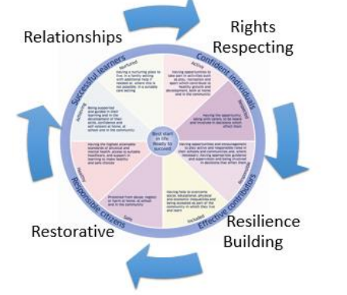
4 Rs

Slide 6
Minimising Incidents

Slide 7
Inclusion Essentials: School Policy
You will have an up to date and publicly available school policy
Relationships, learning and behaviour – The City of Edinburgh Council Intranet
Including:
Statement on Inclusion, Rights, Relationships and Behaviour/Learning
All behaviour is Communication
Prevention and De-escalation techniques
Tracking and Monitoring Inclusion
Communication
Quality Assurance

Slide 8
Inclusion Essentials – Resources
Nurturing Spaces
Wellbeing Hub
Interventions
Appropriate Support Plans & Risk Assessments
Team around the Child – Support Staff included, as appropriate
Team around the School/Learning Community
Strategic IRD
NEW
NEW
NEW

Slide 9
Professional Learning
Relationships Learning and Behaviour whole school training
2 in person workshops
2 My Learning Hub modules (appears as one course but is split into two)
Online component can be done at any time – Course title Promoting Positive Relationships
Behaviour is communication – Inclusive practice – CIRCLE My Learning Hub primary and secondary modules
Behaviour is communication – GIRFEC child / young person’s planning – GIRFEC My Learning Hub modules

Slide 10
Policy into Practice – Hermitage Park

Slide 11
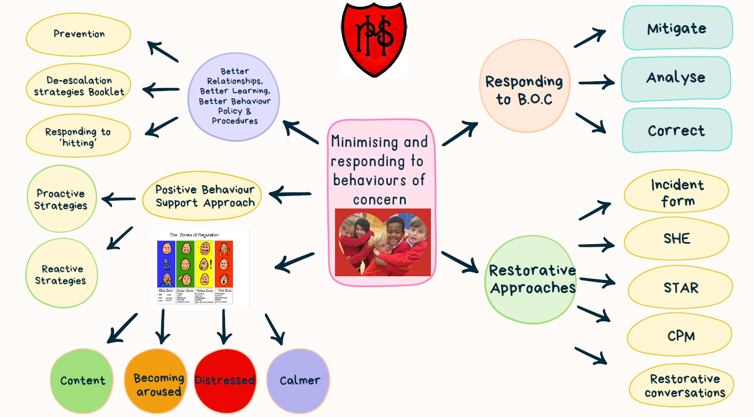
Notes:
Intro-
Nearly 40% pupils simd 1 &2
21 Care experienced chdn
16 ESB
43 CPMs
15 Pupils supported by PSAs (indiv)
So gives you an idea of the possible trauma background context.
In August we launched our revised ‘Better relationships, better learning, better behave policy’.
This was supported by Input on Aug Inset through the Edinburgh Learns ‘Promoting positive relationships’ modules and input from Pam Reid our Ed Psych.
We started the year on a positive note where children came back ready, respectful and safe.
However, Fast forward late Sept and a number of PSAs left and we began to encounter high staff absences.
This meant that our highest need children were having to be supported by adults they hadn’t’ built a relationship with and sometimes even not finding out who that adult would be until that day. Causing distress causing our incidents or B.O.C increasing.
When one PSA went home in the middle of the day telling me ‘I have nothing left to give’ I knew it was critically important to look at our response to Min and responding to B.O.C.
STEPs- Left Min
PSAs Oct Inset really picking apart our Policy- in particular De-escalation strategies’
They decided they wanted to make a quick reference leaflet with their own words which gave quick ideas on physical and communication de-escalation techniques which they have displayed in the staff room.
Hitting de-escalation- Categorsing whether pupils hit because they are Attention Needing, Escape/Avoid something or someone, to get something Tangible, Sensory needs met and suggested strategies to meet each category.
Looked at work of ‘challenging behaviour foundation’ regards to creating ‘Positive Behaviour Support planning’
Proactive strategies making sure the person gets what they need on a day to day basis and includes ways to teach the person appropriate communication skills.
Reactive strategies are designed to keep the person and those around them safe from harm in moments of distress.
5.Took each child they supported and created this PBS based on the zones of regulation. Almost like a crib sheet or a one sided transition passport. So if a PSA was asked to support a child they had never before, they could quickly glance at this sheet to get a positive start.
Green- What does X says and looks like that gives us clues that he is calm and relaxed.
The things that we can do or say to keep X in the green for as much time as possible.
Amber- What X does, says and looks like that gives us clues that he is becoming anxious or aroused.
The things that we can do or say to stop the situation from escalating further and return Leo to the proactive phase as soon as possible.
Red- What X does, says and looks like when he is very distressed.
The things that we can do or say to quickly manage the situation and to prevent unnecessary distress, injury and destruction.
Blue- What X does, says and looks like that tells us he is becoming calmer.
The things that we can do or say to keep him like this.
6. Interventions used after the event to mitigate effects, analyse the event and take corrective action.
Incident form
SHE
STAR - A STAR analysis is a way of assessing what happens before, during and after a BOC.,
SETTING- Where did it happen? What events going on? – any important factors from earlier in the day / day before / something that has generally changed recently (can be anything which is out of the norm, e.g. change of activity, really enjoying an activity, hearing a familiar song, hot weather, sickness etc).
Triggers – were there any noticeable events prior to the distress?
Action –What EXACTLY happened? What did it look like? How long did it last? Who was involved?
Response - Describe how you managed the situation and how the pupil responded to that. How did the behaviour eventually stop? What happened afterwards?
Reflection-any changes needed
CPM- PSAs invited, risk assessments input but also to Attainment meetings
Restorative conversations
Impact-
Early days to document a reduction in BOC but we have observed a positive effect on the relationships of the team around the child.
Before there was a sense of blame directed towards the PSA who supported a particular child when that child exhibited a BOC, and that staff member felt solely resp for him/her. Now with everyone understanding them through the PBS, there is a more collective approach with a understanding that behaviour is communication.
Hopefully that outlines our approach to min and resp to BOC at HPPS.

Slide 12
Managing Incidents

Slide 13
Actions in Schools
Report incident – adult who has been harmed or in near miss
Respond to incident – SLT/BECO
Offer support – SLT/BECO
Record adult Incident on SHE – SLT/BECO
Record child Incident on SEEMIS – SLT/BECO
Follow up/Review of incidents – SLT/BECO
CLOSE THE FEEDBACK LOOP
NEW

Slide 14
An incident Occurs 1
Employee reports to line manager as soon as possible (before end of working day)
Accident resulting in injury
Near miss which would have resulted in injury
BECO must record (or ensure) on SHE within 2 working days (FACTUALLY accurate)
Copy in Head of Education (Area)
Copy in ASL Lead
Confirm to employee

Slide 15
An incident occurs 2 – actions for SLT/BECO
Ensure safety of all concerned
Arrange immediate medical attention/emotional support & continue to monitor, offer counselling, special leave (as required)
Depending on incident, consider
legal/police involvement
FM involvement to make building safe
Calling Head of Education
Significant Occurrence Notification (SON)

Slide 16
Reporting & Follow Up

Slide 17
An Incident Occurs 3
POST INCIDENT REVIEW
Review actions agreed, for example
Risk Assessments and Risk Management Meetings (communicate)
Pupil Support Review and plan
Staff training and essential learning (general and for specific staff)
2 week Lessons Learned Review (SON)
Feedback to Member of Staff confirming
Ongoing welfare support
Actions taken forward at school/authority level
NEW

Slide 18
Policy into Practice – St Crispin’s

Slide 19
BoC – post incident Response
W questions – staff complete incident form
Submitted to Duty Head
Debrief – SLT complete
BSP/RA – Support and challenge
Key points: Time for debrief, support plans reflect reality

Slide 20
BECO Tasks
NEW
Display School Policy and Procedures prominently
Consult BoC Framework
Join School Health and Safety Committee
Present summary of monthly statistics to H&S Committee
Compile analysis, actions following discussion with HT/SLT
Enhanced training
Review of procedures, as required
Follow up actions/Escalation with FM, authority officers etc

Slide 21
School H&S Committee
NEW
BOC Actions
Meets Monthly
BECO, BM, Teacher Rep, FT, Support Staff Rep
Discuss monthly SHE report
Consider
(Enhanced) training
Review of procedures, as required
Follow up actions

Slide 22
Education Service
Head of Education (Area)
On receiving SHE email alert, follow up with HT
Review, investigate, support, (arrange SON)
Arrange 2 weeks Lessons Learned meetings (SON)
On receiving SHE quarterly report (ELT)
Contact schools for reports
Ensure follow up actions have taken place, including training, FM actions, Risk Management Meetings

Slide 23
Education Service
ASL Leads
Quality Assurance of Actions to prevent and respond to BoC
Review school Inclusion policies
Quarterly ASL Team meetings
Self-evaluation and sharing of good practice
Annual summary of incidents and lessons learned
Report to Edinburgh Learns Inclusion Board
Edinburgh Learns Inclusion Annual Report to ECF Committee

Slide 24
Health & Safety Department
Review all SHE submissions and contact schools if RIDDOR report is required
Support and advise Education staff during/following an incident
Collate incident reporting data and prepare summary dashboards
Ensure H&S policies and procedures are up to date and on the ORB
Support Education staff with H&S training

Slide 25
Council Oversight/Governance
SON Meetings and Lessons Learned
Education Management Team
CEJS H&S Committee / Risk Committee
CLT Risk Committee
Council Questions (Elected Members)
ECF Committee (Inclusion Annual Report)

Slide 26
SHE Portal Guidance (further guidance also on My Learning Hub)
Step by step guide on completing the SHE form
This guidance provides managers with information on how to report accidents and incidents on to the SHE portal. step-by-step guide on reporting incidents on the SHE portal.
3. Incident reporting guidelines
This guidance provides managers and employees with information on incident reporting guidelines. incident reporting guidelines.
4. Incident investigation guidelines
This guidance provides managers with information on carrying out health and safety incident investigations. incident investigation guidelines

Slide 27
5. Reviewing and editing records on the SHE portal
You need to be a SHE licence holder to review or edit incident records and to run reports.
Licence holders can review records by logging in to the SHE portal at: sheassure.net/EdinburghCC
6. Licence holder
For managers who would like information on how to become a licence holder, or how to request a user licence for a member of their team contact the Corporate Health and Safety team
7. Unwanted fire alarm signal (UFAS) and fire incident reporting
UFAS and fire incidents should also be reported electronically on the SHE portal. This guidance provides managers and employees with information on how to report UFAS and fire incidents on the SHE portal.
guide to reporting UFAS and fire incidents on the SHE portal
8. Step-by-step guide for reporting incidents and running basic reports on the SHE portal
https://orb.edinburgh.gov.uk/downloads/download/6079/step-by-step-guide-for-reporting-incidents-and-running-basic-reports-on-she
9. Health and safety incident reporting guidelines for managers and employees
https://orb.edinburgh.gov.uk/downloads/download/10959/health-and-safety-incident-reporting-guidelines-for-managers-and-employees---march-2022

Slide 28
Questions

