Slide 1

Real terms-pay cut - Given the current levels of inflation, the offer represents a real-terms pay cut.
Efforts of teachers undervalued: The total value of the offer, now 10 months overdue, fails to recognise or reward the mammoth efforts teachers have made to maintain education throughout the challenge of the pandemic
Just not good enough: A sub-inflationary pay increase is unacceptable.
Education Recovery relies on teachers and teachers should be able to rely on fair and reasonable pay increases.
Cost of living: As we move into 2022 the cost-of-living crisis is hitting hard with inflation and interest rates both on the rise. April’s National Insurance increase will further erode teachers’ pay.
Time for serious negotiation!

Slide 2

GTCS Elections

Slide 3


Permanent, Supply and Temporary Teaching Jobs:
Knowing Your Terms and Conditions
Eilidh Gittus (Edinburgh Organiser)
Alison Murphy (Edinburgh LA Secretary)

Slide 4
What We Will Cover
A Look at the Definitions
National and Local Negotiations
SNCT Code of Practice
Permanent Contracts-Duties and Pay
Short Term Supply- Duties and Pay
Fixed Term/Temporary Contracts- Duties and Pay
What to Expect from the Employer
EIS Structures and How to Get Involved
Over to you…

Slide 5

Definitions
Permanent…Supply … or Fixed Term/Temporary Contract?
Permanent:
No fixed end-date. Full or part-time contract. Full Time (FTE)=35 hours.
Part Time (PT)=pro rata of 35 hour week.
Short-Term Supply:
Short term engagements of up to two days.
Fixed Term / Temporary:
Engagement of three days and over.

Slide 6

Nationally Negotiated Terms and Conditions
The Conditions of Service for all teachers working in local authorities in Scotland are determined through the Scottish Negotiating Committee for Teachers (SNCT).
The SNCT sets a number of your contractual terms and conditions at national level, including:
  Pay
  Sickness Allowances
  Class Size Maxima
  Maternity/ Parental Leave and Pay
The EIS has the largest number of representatives on the teachers’ panel of the SNCT.
EIS representatives are elected teachers, ensuring a strong link between those negotiating your terms and conditions and the realities in the classroom.
Your full terms and conditions are contained in the SNCT handbook and can be accessed via www.snct.org.uk.

Slide 7
Locally Negotiated Terms and Conditions
SNCT devolves a number of matters to Local Negotiating Committees for Teachers (LNCTs)
EIS representatives negotiating at LNCT level are practicing teachers
Many of these devolved matters have particular relevance for those engaged in supply work or fixed term contracts
They include:
  cover agreements,
  appointment procedures,
  specific duties and job remits,
  transfer of temporary teachers to permanent staff,
  leave and absence arrangements and
  disciplinary and grievance procedures.
They can be found in the LNCT section of the SNCT website: https://www.snct.org.uk/lnctAgreements.php

Slide 8
Working Year and Working Week
Teachers (other than short term supply teachers) shall have a 35 hour working week. The working week shall apply on a pro rata basis to teachers on part-time contracts.
Within the 35-hour week, a maximum of 22.5 hours will be devoted to class contact.
An allowance of no less than one third of your actual class contact commitment is for preparation and marking (7.5 hours). The use of remaining time (5 hours per week) will be subject to negotiation in your annual Working Time Agreement.
All tasks which do not require the teacher to be on the school premises can be carried out at a time and place of your choosing
If you are required to travel between schools during the school day, that time is regarded as pupil contact time.
Notes:
The pro rata arrangements for teachers on part-time contracts, relating to remaining time, shall occur on days when the teacher is employed. The exception to this rule is parents’ meetings when the part-time teacher will comply, on a pro rata basis, with the arrangements agreed for the establishment.
Travel time…except during the midday break when the teacher shall have a personal break of not less than 40 minutes.

Slide 9

Permanent and Fixed Term Contracts: Duties
Expected to carry out the main duties of all class teacher
Subject to the policies/practice of the school/local authority
These duties include: -
manage and organise classes through planning and preparing for teaching and learning
assess, record and report on the work of pupils’ progress to inform a range of teaching and learning approaches
prepare pupils for examinations and where required, assist with their administration
contribute towards good order and the wider needs of the school
develop the school curriculum
contribute to the school and council planning and improvement processes.
maintain and develop knowledge and skills and contribute to the professional development of colleagues including probationary and student teachers.

Slide 10
Fixed Term Temporary Contracts
A fixed term temporary contract will have a clear end date. The use of a fixed term temporary appointment may be made in a number of circumstances including the following:
• maternity leave;
  • parental leave;
  • adoption leave;
  • career break;
  • long term sickness absence;
  • secondment;
  • sabbaticals
  • staffing from time limited funding; and
  • pattern of recurrent work

Slide 11

Permanent and Fixed Term Contracts: Pay
Those engaged on fixed term contracts are paid in the same manner as those on permanent contracts.
The details on how teachers’ pay is calculated are contained in the Part 2, Appendix 2.19 (National Pay and Leave Specification of the SNCT Handbook). A link to this can be found below.
SNCT Handbook, Part 2, Appendix 2.19
Pay Point | Annual Salary
0 | 27,498
1 | 32,994
2 | 34,863
3 | 36,891
4 | 39,231
5 | 41,412

Slide 12

SNCT Codes of Practice for Supply Teachers
Local authorities as employers are required to draw attention to the two main SNCT Codes of Practice of relevance to those engaged in supply work.
Appendix 2.8 - Code of Practice on the use of Temporary Contracts.
Appendix 2.8A - Code of Practice on Short-Term Supply.
www.snct.org.uk

Slide 13
Short Term Supply: Duties
Some of the main duties of teachers on short-term supply differ from those engaged on fixed/long-term contracts.
The main duties of teachers engaged in short-term supply are to:
Teach assigned classes
Correct work, as part of ongoing classwork
Maintain a record of work
Contribute towards good order in the school

Slide 14
Short Term Supply: Pay
Pay for short-term supply is calculated on the hourly rate –235 Days x 7 Hours of the annual rate of salary for teachers.
Rate will depend on the incremental point on the Main Grade Scale that the teacher qualifies for
All those engaged in short-term supply receive a 10% uplift in their pay for preparation and correction time.
Supply teachers may only be engaged in a ‘full’ or ‘half’ day block.
No cap on the maximum class contact time for short-term supply teachers.
Those having difficulty calculating rate of pay should contact payroll department

Slide 15
The reality of supply work in Edinburgh
Managed by CEC
Very important to check they have all correct details
Currently, emails with “offers” – first come, first served
If doing a short term supply engagement:
Paid via timesheet – fill in hours you are with a class
You have a right to be employed for the full day (or half day)
If turn up, must be paid…
Vital to get timesheet signed, and always take a copy
Paid in arrears – effectively, two months

Slide 16
Fixed term contracts
If known at the outset that vacancy will last more than 3 months, it should be advertised.
If appointed to this sort of contract, will go onto payroll – no timesheets etc.
Do check specifics around holiday pay (it’s complicated!)
Beware of overpayments – they MUST be refunded, even if not your fault

Slide 17
“Long term supply”
Long term supply – according to the SNCT, there is no such thing. As soon as you are doing more than 2 days in one school (including the same day each week) you are on a fixed term contract…
However, reality is more messy…
If you are in a school for MORE than 2 days, then this is what should happen:
22.5 hours contact time, but working full 35 week (or it can be part time – check!)
Still do timesheets – but different multiplier (keep copies!!!)
Not usually issued with written contract, but can request it

Slide 18
What to Expect From Your Employer:
Short-Term Supply
Local authority employers must: –
ensure short-term supply is managed correctly and efficiently.
must carry out the actions as set out in Code of Practice on Short-Term Supply (SNCT Appendix 2.8A
Fixed Term Contracts
Local authority employers should: -
ensure a fixed term or temporary contract is issued in accordance with nationally agreed SNCT conditions of service and the relevant local devolved procedures.
* Edinburgh have a Local Agreement about permanency after 2 years.
* Employers need to make any contract permanent after four years consecutive service.

Slide 19

What to Expect From Each School:
Headteacher – responsibility to ensure engaged in accordance with Code of Practice.
You should be afforded all the relevant information you require including:
School day timings.
Class timetable
Planned work / lesson plans.
Medical Action Plans and Additional Support for Learning information
Relevant Child Protection documentation.
Class registration details / details of registration process.
Access to Resources such as stationery and IT equipment.

Slide 20
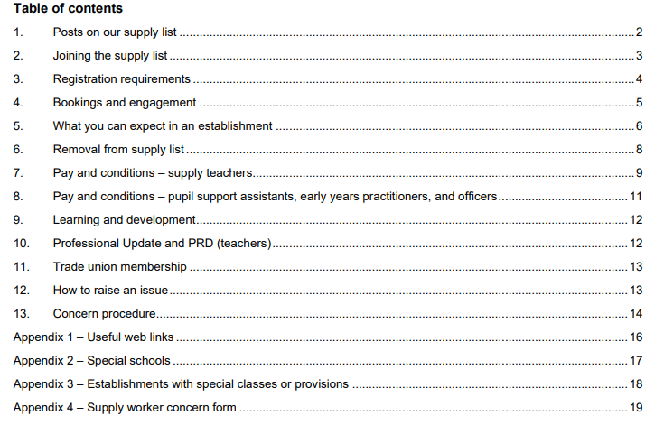
What is Expected of You?
City of Edinburgh Council has produced a handbook for supply teachers working in Edinburgh schools.
Information will come to you from CEC so please check your emails!

Slide 21
What we’re doing in Edinburgh to support supply teachers:
Talks with CEC around booking systems etc
Challenging where pay etc incorrect
These sessions! Knowledge is power….
We keep offering joint training for HTs and BMs…
Ongoing discussions around recruitment processes
Pushing for more permanent contracts
Supporting informal networks
Supporting individual members with issues around maternity, sick pay, entitlement to permanency
Looking to raise profile of, and support for, supply teachers in schools
Several motions have gone to EIS HQ for national action…

Slide 22

What To Do If Things Aren’t Right:
Check - is practice in line with SNCT Appendix 2.8 (fixed term / temporary contracts) or Appendix 2.8A (short-term supply)
If there are issues make contact with your EIS School Representative.
For advice contact your EIS Local Association Secretary, Alison Murphy edinburghla@eis.org.uk

Slide 23

EIS Support and Getting Involved
Find out who the EIS Reps are in your school
Identify your EIS Local Association Secretary
Visit the LNCT sections of the SNCT website- know where to go for local agreements www.snct.org.uk
Attend EIS Branch meetings
Find out about events/ training on offer through your EIS Local Association
If your school does not have a rep contact your Local Association Secretary and Organiser egittus@eis.org.uk

Slide 24
Over to you…

