Slide 2
EIS Highland LA
Reporting Violent & Aggression Behaviour
This session will look at:
The current context of V&A incidents in schools
What to do and expect after a V&A incident
Next steps for school branches
Opportunity for questions
Alistair Bell – EIS Highland LA Secretary (highland@eis.org.uk)
Craig Carson – EIS Organiser (ccarson@eis.org.uk)
Dan Thompson – EIS Organiser (dthompson@eis.org.uk)

Slide 3
Background…how did we get here?
Violent and aggressive behaviour in classrooms is not a new phenomenon, but it has increased exponentially in the last ten years.
Reasons for this include:
Year upon year of systemic lack of investment in Scottish schools;
Societal factors – poverty, increases in mental health issues, cuts to support services
Covid – the lockdown compounded existing issues and inhibited social and emotional development. Many young people experienced delayed speech and language skills;
Lack of real investment in Education Recovery;
Since 2010, ASN numbers have been increasing. In December 2023, the Scottish Government reported that 37% of school children have an ASN;
Teacher numbers are falling, and specialist teachers are diminishing;
We have large class sizes and the third highest contact time of all OECD countries.
Schools can’t deal with this alone.

Slide 4
EIS Highland 2023 V&A Survey Results
School branches reported:
87% of teachers experience V&A incidents on a weekly basis (70% daily)
97% felt that V&A incidents have increased over past 4 years.
The most common types of V&A incidents towards teachers were:
Physical violence towards a teacher
Intimidatory, obscene or derogatory verbal comments towards a teacher
43% were aware of the school’s V&A ‘policies & procedures’
57% felt that ‘sometimes’ teachers were supported after a V&A incident had been reported (14% always supported)
80% stated “members of the branch” considered leaving teaching as a result of the violence and aggression.
37% believed parent/carer-on-teacher V&A was becoming more frequent.
More ASN support – staffing or appropriate accommodation, de-escalation and CLPL training. Colleagues supporting each other following such incidents works well, and strong staff relationships are vital.

Slide 5
Incident Reporting
What is an incident?
Pupil-Staff Incidents are either purposeful or reactive behaviours by pupils that either intentionally or unintentionally produce damaging or hurtful effects, either physical or emotional, on staff members.
Verbal and Physical abuse of staff must be reported.
Why report incidents?
Employers need to provide a safe working environment, and incident reporting is key to informing the employer of actual and potential incidents and accidents.
Incident reporting is used to inform the Risk Assessment process and to identify possible risks.
To help identify where extra support can be offered or may be needed.

Slide 6
Overview of Reporting Process
Pupil Staff Incident occurs in a school, local authority ELC setting or off-site ASfL provision
Staff member affected completes the ‘PSI Reporting’ online form
Staff member’s Line Manager carries out a debrief of the incident and completes the ‘Line Manager Incident Debrief’ follow-up online form

Slide 7
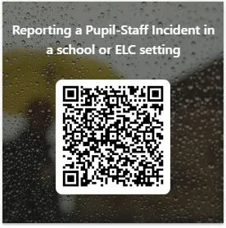
Guidance and Location of Pupil-Staff Incident (PSI) Reporting Form
Guidance on completing a PSI Reporting Form can be found here.
PSI Reporting Form
https://forms.office.com/r/gSp6UVwuST.

Slide 8
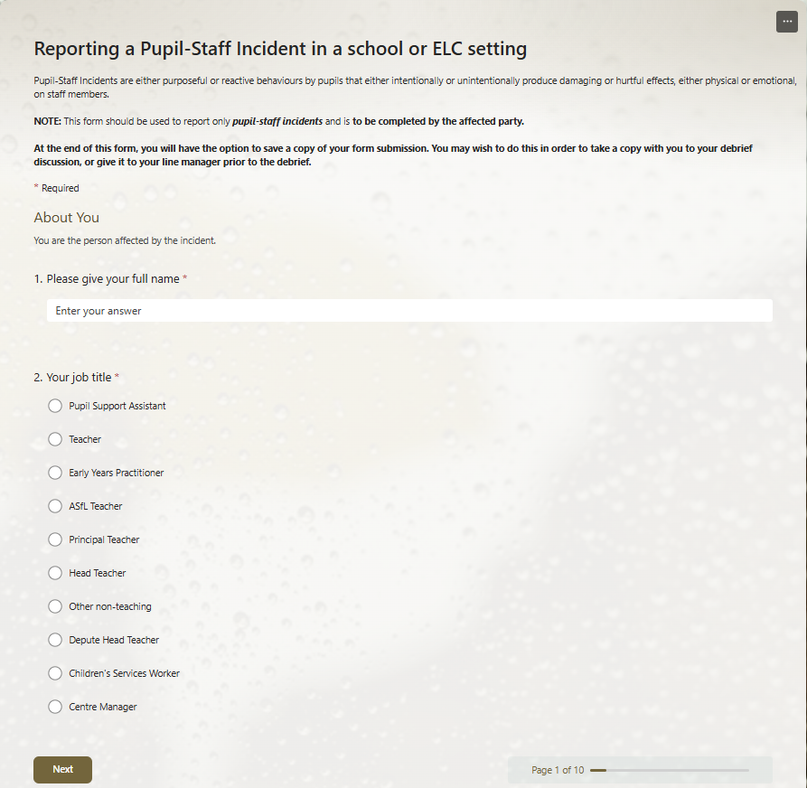
Completing a PSI Reporting Form
Ensure you have the correct email address of your Line Manager before starting.
Record only factual information – avoid suppositions or opinions.
At the end of the form, there is an option to save a copy and you should do so.
Once the form is submitted, an email is sent to Line Manager notifying them an incident has taken place. It asks them to carry out a de-brief and complete an online form.

Slide 9
What to Expect at a De-brief
Should either be HT or appropriate Line Manager
You should be emotionally ready for the discussion
It should take place in a “safe, controlled, non-judgmental environment”.
Should take place 24-48 hours after the incident with line manager section of the PSI form completed within a week.
Discussion should focus on the following – description of incident, reflection, influencing factors, changes and learning.
“Staff should feel supported and not that the debrief is about criticism of their practice.”
“Category of Incident” should be discussed either Category 1 (low level or low impact) or Category 2 (high level or high impact).
Paperwork to be completed after de-brief:
Line Manager completes Pupil-Staff Incident Line Manager follow-up form
Updated risk assessment and the Positive Behaviour Support Plan
H&S and RIDDOR if relevant
*all taken from PSI Guidance document

Slide 10
At a National Level…
Continue to push for more resourcing for schools with all political parties
National expectations around positive behaviour including collecting data.
Influence the delivery of National Action Plan on Pupil Relationships & Behaviour
Support the work of EIS Local Associations
Update EIS national behaviour survey from 2023
At a Local Level…
The EIS have been raising this issue with Highland Council both at formal and informal meetings.
At Highland’s Local Negotiating Committee for Teachers (LNCT) this has been the only workplan item along with reviewing current agreements.
This session, the EIS has met twice with Asst. Chief Exec and Senior Officials to agree an action plan based on a staff survey (results still being analysed).
Local EIS have met branches and are keen to meet more to discuss pupil behaviour and other issues

Slide 11
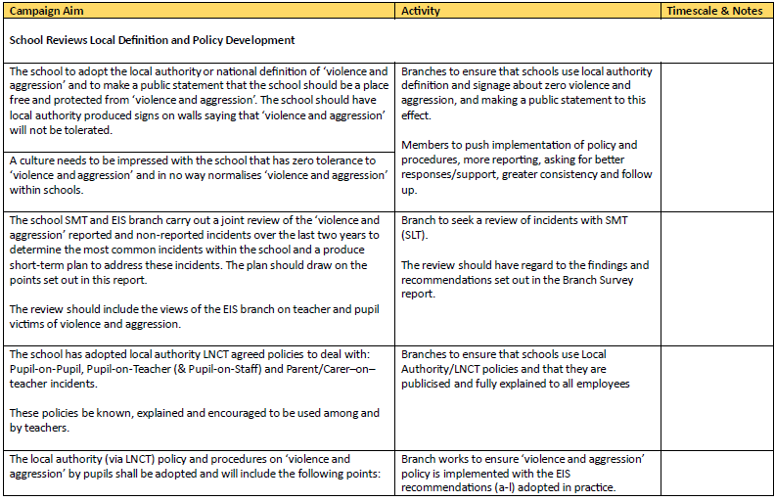
Next Steps for Members & Branches
https://www.eis.org.uk/Content/images/Campaigns/QualityEducation/VASU4QEBranches.pdf

Slide 12
Next Steps for Members & Branches
No EIS rep in your school? Consider being the rep or be part of a group of reps!
Violence is a Health and Safety issue. Health and Safety Reps have a huge role in this area. Have you considered being one?
Encourage people to report. Reporting won’t solve everything, but not reporting means that the true scale of the problem is never fully understood. This also means that the pupils involved may never access the support they need because appropriate reporting doesn’t take place.
Campaign for appropriate support for teachers following a violent incident, e.g. minimum level of support (space, time for recovery, risk assessment, investigation). Hold a meeting with branch members. What would a minimum level of support look like? Ask for a meeting with your HT/SLT.
Remind people that accident/incident claims can be made through the EIS – especially if the incident was foreseeable and preventable.
Remind members that this is a wider, societal issue. Don’t enter into the blame game e.g. “He/she was fine with me last year…”
Support each other. Build confidence in each other.

