Slide 1
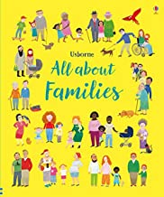
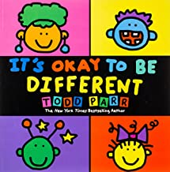

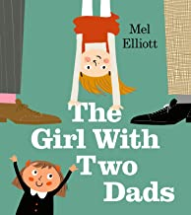

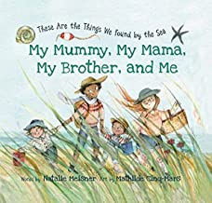
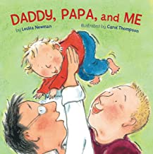
Usborne all about families:
Felicity Brooks and Mar Ferrero.
It’s ok to be different:
Todd Parr
Love makes a family:
Sophie Beer
The Girl with Two Dads:
Mel Elliott
And tango makes three:
Justin Richardson
My Mummy, My Mama, My brother and me: Natalie Meisner
Daddy, papa and me:
Leslea Newman and Carol Thompson

Slide 2
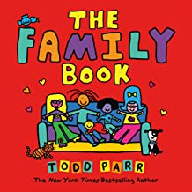
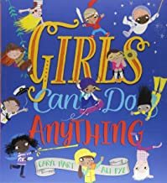
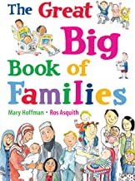

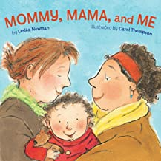

The family book:
Todd Parr
Girls can do anything: Caryl Hart and Ali Pye
The great big book of families: Mary Hoffman and Ros Asquith
Picnic in the park:
Joe Griffiths and Tony Pilgrim
Mommy, mama and me: Leslea Newman and Carol Thompson
My Daddies: Gareth Peter and Garry Parsons

