Slide 1

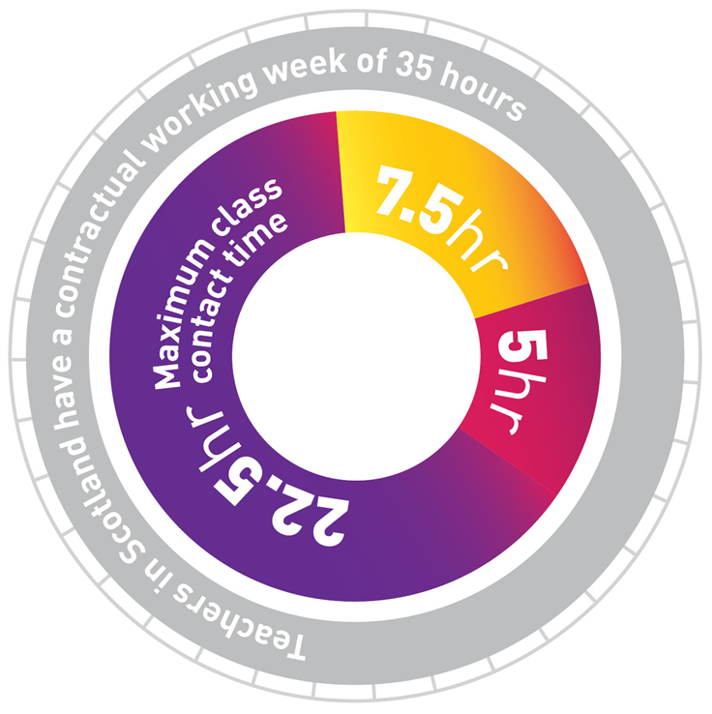

Working Time Agreements
Empowering Members to Tackle Workload

Slide 2
“The individual and collective work of teachers should be capable of being undertaken within the
35-hour working week.”
SNCT Code of Practice on Working Time Arrangements for Teachers

Slide 3
What is excessive workload?
Anything that makes it impossible for teaching staff to complete their duties within the 35-hour week *
Climate of collegiality must underpin enhanced professional role of teachers
Due regard to workload and contractual obligations to allow time for core role as leaders of learning
*SNCT Statement of Teacher Professionalism (Part 2: Appendix 2.6)

Slide 4
Introduction
Working Time Agreements should provide the context to undertake the collegiate activities set out in the SNCT Handbook (Appendix 2.7) and should also inform the priorities, time and resources in a School Improvement Plan
WTA at school level is a collective agreement reached between trade union(s) and management side.
Must take account of LNCT agreement LNCT Agreements (snct.org.uk).
Binding on all members of teaching staff in the establishment, including promoted post holders.

Slide 5



Three is a magic number…
School Improvement Plan: The School Improvement Plan must have at least a framework for the school improvement priorities over the next session. These should be few in numbers and have time costings for development activities. These time costings inform hours allocated to curriculum development/working groups etc.
School WTA: The Working Time Agreement should consider the time available for collegiate activities within the 35-hour working week.
School Calendar: This must be completed in conjunction with the Working Time Agreement and should take account of part-time staff. The timings and length of meetings should be carefully considered.

Slide 6
Contractual 35-hour Working Week
22.5 hours maximum class contact
7.5 hours personal planning and preparation
5 hours collegiate time *
* Part-time staff on pro-rata basis

Slide 7
“Workload management must form an integral part of discussions as part of the planning process to ensure that the individual and collective work of teachers is capable of being undertaken
within the time available.”
SNCT Code of Practice on Working Time Arrangements for Teachers (Appendix 2.7)

Slide 8
Core Collegiate Activities
Additional Time for Planning, Preparation and Correction
Parents’ Meetings
Preparation of reports and records
Formal Assessment/Tracking
School Improvement Plan activities
Staff Meetings
PRD
Additional Supervised Pupil Activity*
Trade Union Meetings
Flexibility
*this should be voluntary unless agreed by all staff

Slide 9
Flexibility
WTAs include a category for flexibility
These hours are determined at school level but must take account of the local agreement.
Flexibility is built in to account for any unplanned events/ activities that may arise. E.g. local authority or HMI inspections
The same principles must be applied to the “flexibility” component as the rest of the WTA i.e. the Branch and the Headteacher must agree on the use of these “flexible” hours.

Slide 10



Concepts of Time
5 hours collegiate contractual time in each 35-hour working week.
Actual Time – includes travel time, preparation and follow-up as appropriate.
Indicative Time for activities – arrived at through professional audit. Possible use of pro-forma/survey.

Slide 11
WTA Preparation – General Review
Review - What didn’t work last year? What needs to change?
Discuss – members propose changes at branch meeting to address priorities and workload
Decide – Branch meeting decides proposals for SNC negotiation with HT

Slide 12
School Negotiating Group
Please refer to your LNCT Agreement or LA Secretary for good practice within your LA
Teachers’ Side –largest union in establishment nominates their Convenor
Teachers’ side should reflect balance of union membership
A draft WTA Agreement should be put to the Branch for approval

Slide 13
EIS School Branch Committee: WTA Preparation
Never just agree to last year's WTA.
Professional Audit –Evidence-based assessment of time taken by teachers to complete each collegiate activity in the year –use a spreadsheet or pro-forma to ask/survey members (individual, stage or dept returns).
Outcome returns from Professional Audit used by EIS Branch to decide time demand for each activity.
Present stress point issues (transition, GIRFEC, ASN etc) with narrative proposals particularly when indicative time allocations do not meet the needs of specific teachers.

Slide 14


Process
Every school should have a School Negotiating Group/Committee.
An audit of the WTA should be carried out annually- This is an evidence-based assessment of time taken to complete each collegiate activity in the year. This audit can be completed individually, as a branch or as a department/faculty.
The audit of last year’s WTA should be used to allocate indicative times for statutory duties - parents’ meetings, report/records, assessment, etc.

Slide 15
The School Improvement Plan and Anything New
SIP priorities should be identified and time-costed in advance of negotiating WTA.
If any new systems (IT, reporting etc) or courses/schemes of work are to be introduced, plan that these will take more time to embed.
No new systems or course/schemes of work should be introduced throughout session; they will have to wait until the following session.

Slide 16
WTA Calendar
The Calendar must be completed alongside the WTA.
Insert indicative times (max 5 hours per week) for statutory duties (parents’ meetings, reporting etc) and working backwards add other events into the WTA calendar. A spreadsheet can be useful to calculate hours.
Make sure hours reflect time taken-preparation, reading, follow-up etc.
Based upon learning and teaching needs, insert indicative times for SIP activities.
Review activities carried out last year and prioritise any time left.

Slide 17
Developing Issues and Remodelling
School Negotiating Committee/Group will need to “reschedule” parent’ meetings and other professional activities if need be.
Prioritisation will mean some activities cannot take place unless time is freed up.

Slide 18
Branch Decision Making
Audit process by branch
Revise/amend as per branch decision
Advise other TUs of EIS position
Present proposals to management for negotiations
Take outcome of negotiations back to branch for decision
EIS Rep signs off agreement

Slide 19
What Happens Next?
Failure to Agree
Once your school has agreed the WTA (and calendar) for the following session, it should be submitted to the Joint Chairs of your LNCT.
If you are unable to reach agreement, then the LNCT should be notified of a failure to agree. School branches should contact their LA Secretary early in the negotiation process if this looks a likely outcome.

Slide 20
What Makes a Good WTA?
Completed WTA takes account of LNCT advice.
WTA is a collective negotiation beginning with branch discussion led by EIS Rep/s
WTA is an inclusive process where all members have the opportunity to participate
Evidence gathered throughout year forms basis for negotiations
Accompanied by calendar that details hours spent on activities that cannot exceed 5 hours per week
Detailed breakdown of hours for each activity
Takes account of part-time staff on a pro-rata basis
WTA signed off by HT and EIS Rep
WTA should include resources required for SIP
Returned within time outlined in LNCT agreement

