Slide 1
National Qualifications 2021
EIS
5 May 2021

Slide 2
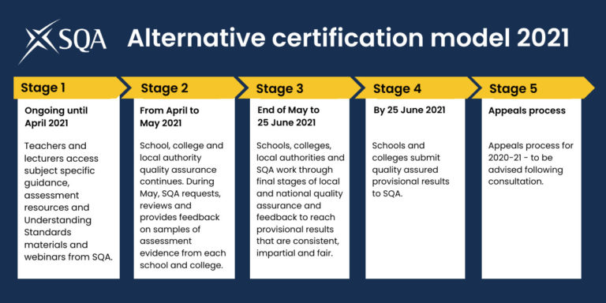
The Alternative Certification Model

Slide 3
Alternative certification model - roles and responsibilities
Sets out responsibilities for SQA, teachers/lecturers, centre senior managers, local authorities, SCIS, Education Scotland between now and 25 June to ensure provisional results are robust and credible
Co-created with key partners: the Association of Directors of Education in Scotland (ADES), Colleges Scotland, Education Scotland, the Educational Institute of Scotland (EIS), School Leaders Scotland (SLS), the Scottish Council of Independent Schools (SCIS), Scottish Qualifications Authority (SQA), the Scottish Government, National Parent Forum of Scotland, and the Scottish Youth Parliament.
Equalities and children’s rights and well being considerations underpin all decisions and actions
Shared responsibility for communicating the ACM and securing
stakeholder buy in and public confidence

Slide 4
Work to date
Modifications to assessment requirements following consultation: recognising disruption to learning and maximising learning and teaching
Publication of National 5 (pre-Christmas), Higher and Advanced Higher (post-Christmas) subject-specific guidance and assessment materials following cancellation of exams
Extensive programme of Understanding Standards materials and online events
Demonstrated attainment at the heart of the alternative certification model (ACM)
Publication of revised co-created alternative certification model for National 5, Higher and Advanced Higher including roles & responsibilities and impact assessments for Equalities and Children’s Rights & Wellbeing

Slide 5
Quality Assurance prior to the submission of provisional results
All provisional results are based on quality assured evidence of demonstrated attainment
Assessment evidence is quality assured both locally by centres and local authorities and nationally by SQA
Provisional results submitted by 25 June 2021
SQA will not change these provisional results, but will check for any administrative errors by centres when entering their data into our system.

Slide 6
National Quality Assurance exercise
Includes all centres who deliver National Qualifications at National 5, Higher and Advanced Higher and includes all subjects and levels
Involves a proportionate selection of courses from every centre, at one level only. Centres were advised of selections on 28 April
Selections are random with some centres selected as new to delivering a subject
Centres to select assessment evidence from 5 learners across a range of attainment from all teachers, if possible, delivering the selected course
Assessment evidence can be partial or incomplete and can be in paper or digital format (must be same for an individual learner)
Supportive specific feedback will be provided to all centres for subjects selected
Key themes/messages for most subjects/levels – available for all centres

Slide 7
Other key points
Consultation on Appeals for 2021 completed
Made adjustment to assessment of National 4 – added value unit assessment is optional for current session
Vocational qualifications – making modifications to assessment overseen by HNVQ 2021 Group. Guidance issued to schools Wednesday 10 March with tailored message for learners
Engaging with educational stakeholders to consider approaches for session 2021-22 for National and Vocational Qualifications
Any enquiries to qualification.development@sqa.org.uk

Slide 8
Communication
Learner voice: SQA learner panel in partnership with the Scottish Youth Parliament (SYP)
Clear communications for parents/carers and learners: working with NPFS and SYP on format and tone of communications.
Vocational qualifications guidance published for schools and local authorities
Dedicated web space for both NQ and HNVQ 2021 information sqa.org.uk/NQ2021 and sqa.org.uk/HNVQ2021
Ongoing promotion of Understanding Standards materials, subject-specific guidance and assessment resources for 2021
Providing further information for schools and colleges about national quality assurance, centre guidance published on 23 April
Provided update to centres on stage 2 of ACM on 13 April
Ongoing communications with SQA Appointees
Continue to engage with Professional Associations
Consultation on Appeals for 2021

Slide 9
Questions?

