Slide 1
Negotiating Working Time Agreements
Alison Murphy
LA Secretary

Slide 2
COURSE OVERVIEW
Preparation and audit process
Branch decision making
Communication and approach
Tips for negotiation and trading
Notes:
Consideration of how to control excessive workload and safeguard members’ health and wellbeing should be at the forefront of all discussions.

Slide 3
Background
School Improvement Plan
SIP Formulation
SIP Implementation
Progressed by
INSET activities
Funded CLPL activities
Teachers agreeing to use some of their 35 hours
Working Time Agreement.
Notes:
Paper approved by Exec in 2010 following on from Paper in 2001. SIP offers some protection against excessive workload and some control over the pace of change. It cannot resolve all issues of workload-teachers must take control individually and collectively.

Slide 4
Introduction
WTA at school level - collective agreement reached between trade union(s) and Headteacher as “agent of the authority”
Binding on all members of teaching staff in the establishment
Covers 5 hours per week in a 39 full week equivalent working year
Signed off as agreed by Rep and Headteacher
Notes:
If the EIS is the majority union in the school, it is the EIS Rep that co-signs.

Slide 5
WTA - Contractual 35 Hour Working Week
22.5 hours maximum class contact.
7.5 hours preparation and correction.
5 hours collegiate time with arrangements agreed at school level between HT as agent of Local Authority and EIS Rep on behalf of members.

Slide 6
Core Collegiate Activities
Additional Time for Preparation and Correction
Parents’ Meetings
Preparation of Reports
Formal Assessment/Tracking
Planning
Staff Meetings
PRD
Additional Supervised Pupil Activity
SNC meetings
Flexibility

Slide 7
Concepts of Time
5 hours collegiate contractual time per 35 hour working week.
Actual Time – time needed for designated meetings,
Indicative Time for activities – arrived at through professional audit.
Possible use of pro-forma.
Notes:
Actual time-parents’ meetings
Indicative time-reporting

Slide 8
Concepts of Time - Audit

Slide 9
WTA Preparation – General Review
Review - What didn’t work last year? What needs to change?
Revise –SNC (union side) proposes changes at branch meeting to address this.
Decide – Branch meeting decides proposals for negotiation with HT.
Notes:
Professional Audit – Evidence-based assessment of time taken by teachers to complete collegiate activities – use a pro-forma to ask members (individual, stage or department returns).
Use Results of Audit to decide indicative time allocations for each collegiate activity and when in the year they require to be inserted in school calendar.

Slide 10
WTA Preparation – Time Allocations
Activity | Time (hours)
Parents’ Meetings | 0-15
Staff/Stage Meetings | 0-20
Development Time | 0-50
Planning/Preparing/Assessing/Tracking/Reporting | 0-70
PRD/Professional Update | 0-5
Union Meetings | 0-5
ASN/GIRFEC Agenda | 0-20
Flexible Time | 0-10
Total | 195
Suggested Primary Time Allocation
Notes:
Consider balance of hours allocated to activities such as planning, moderation, and curriculum development - does this work for your school?
Ensure time for professional dialogue – look at balance of meetings and consider alternatives.
Remember to leave flexible time-we know that teachers will have extra preparation/correction to deal with as well as events such as school inspections etc.

Slide 11
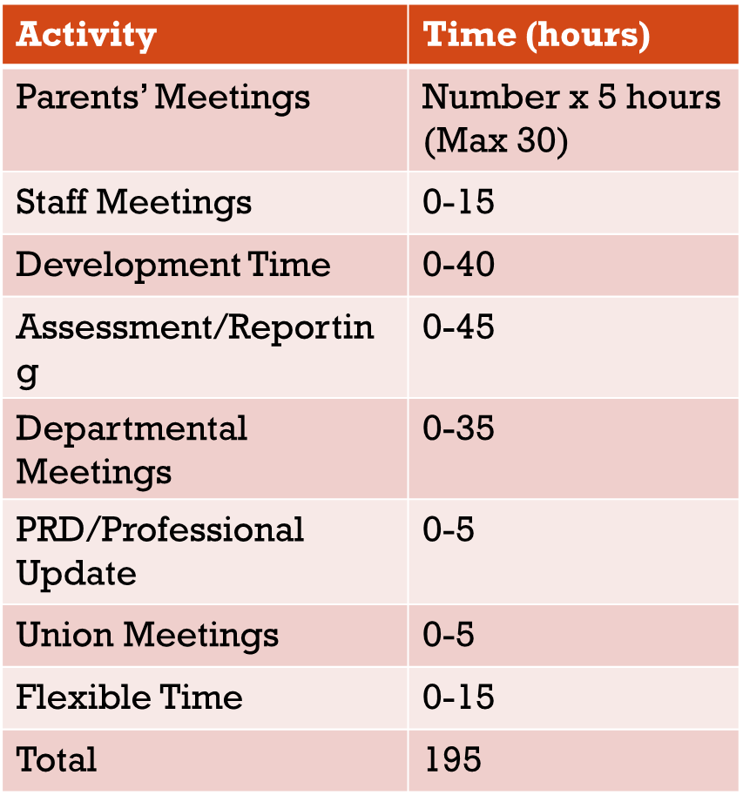
WTA Preparation – Time Allocations
Suggested Secondary Time Allocation
Notes:
The calendar spreadsheet will now be filling up, with events having to be re-arranged to fit in with time required contending with time available.
Ensure other priorities for Teaching and Learning are addressed within the calendar spreadsheet.
(Tracking should be included within ‘Assessment’ or be given a distinct ‘row’ on the spreadsheet.)
Address stress point issues with narrative proposals particularly when indicative time allocations do not meet the needs of specific teachers. Proposals to free extra time can include being temporarily removed from need to attend whole school assemblies, cover duties, etc.

Slide 12
WTA Preparation – When?
Begin to populate the WTA spreadsheet in the following order:
Look at the Core (Whole School) Collegiate Activities
Parents Meetings
Reporting
Assessment (incl. prelim)/Tracking
Look at other Core (Whole School) Collegiate Activities
Departmental Meetings
Staff Meetings
SNC Meetings
PRD

Slide 13
Contending and Changing Priorities
Time allocated for specific activities.
When they should take place in the week/year.
Teacher v Management priorities.
Covid-19 changes

Slide 14
Branch Decision Making
Present fleshed out proposals to branch meeting.
Revise/amend as per branch decision.
Advise other TUs of EIS position.
Present proposals to management for negotiations.
Take outcome of negotiations back to branch for decision.
EIS Rep signs off agreement.

Slide 15
The Edinburgh WTA
https://www.eis.org.uk/edinburgh
Branch meetings where HT is an EIS member…

Slide 16
What happens next…
Once your school has agreed the WTA for the following session (and a calendar of events) it should be submitted to your LNCT.
If you are unable to reach agreement, then the LNCT should be notified of the failure to agree. School branches should contact their LA Secretary early in the negotiation process if this looks a likely outcome.

Slide 17
Negotiation
and
Communication

Slide 18
Negotiation
What is negotiation?
A useful skill
A process
A form of communication
Why should we negotiate?
Balance of Power
Notes:
‘Negotiation is a process by which parties move from their initially divergent positions to a point where agreement may be reached.’
Negotiation is an everyday activity, its not necessarily a formal set piece affair. There are many definitions, but the key factors are PERSUASION and COMPROMISE.
Need co-operation and commitment between parties. No imposition = Balance of Power

Slide 19
Balance of Power
Never Underestimate Your Own Power!
To reward – give what the other side wants.
To threaten – deny what the other side needs.
Legitimate argument – factual, logical, beneficial.
Sympathy

Slide 20
Balance of power
Confidence
Knowledge
Belief
Preparation
Research
Help
Notes:
Redressing the generally accepted balance of power within a school establishment thorough these skills/activities.
EIS support available including primary and secondary leaflets.

Slide 21
Preparation
Roles:
Who will lead?
Who will take notes?
Determine what:
* You MUST get
* You SHOULD get
* You COULD get
Considerations:
What are the issues to be negotiated?
What are your objectives?
What are the priorities?

Slide 22
Approach to Negotiation
Win – Lose
Negative, confrontational
Likely to break down
Win – Win
Compromise, collaboration
Aim is to reach agreement
Notes:
Need to manage the expectations of members

Slide 23
The Negotiation Process
Interests
Options
Alternative
Communication
Relationship
Commitment
Legitimacy
Notes:
Look for interests behind positions. Prioritise your interests. Other side’s interests?
Working together to make more? Value in differences?
Decide on Best Alternative to a Negotiated Agreement. Can’t meet it ? – Walk away.
Fairness? What criteria should be used?
This is a legitimate process defined in national ts and cs
Relationships need to be separated from the substance of the agreement.
Clarify what the meeting outcomes are?

Slide 24
Communication
Verbal language:
From what you have been saying it would seem ….
It is not our normal practise to ….
We had not anticipated that ….
Under normal circumstances ….
From what you are asking ….
Body language

Slide 25
CoMmunication
AGGRESSIVE
Dominate. Ignore others’ rights. Loud. Refuse to listen.
PASSIVE
Non-communicative. Linked to frustration and low-esteem.
ASSERTIVE
Communicate openly. Sharing ideas and listening. Put fear of rejection into context and make choices.
Notes:
=> Improves self-confidence, leads to honest relationships and achievement of objectives.

Slide 26
Communication & Approach
Seek clarifications to avoid any possible confusion.
Don’t be apologetic:
“Maybe it’s me, but I don’t understand …”
Don’t be aggressive:
“You haven’t made that clear.”
Be responsive:
“When you say that, do you mean x or y?”
“Have I got it right, what you are saying is …?”

Slide 27
Communication & Approach
Don’t argue – ask questions
Not “You’re wrong because …”
But “Why do you say / believe that?”
Not “That isn’t true.”
But “What makes you believe that?”
and then respond with your views or beliefs, using “we” statements
“We don’t agree, because …”
“Our information is … and this leads us to conclude …”

Slide 28
Communication & Approach
Don’t be afraid to repeat yourself – ‘the broken record’.
Don’t interrupt but keep your thought until an appropriate opportunity arrives. Write it down as it occurs to you if necessary. If, however, you feel it is important to make your point at a particular time, indicate non-verbally your wish to interrupt first.
Don’t be interrupted. If an attempt is made to do so, say “I’d just like to finish what I’m saying”, or, “Let me just finish …”.
If you are interrupted, don’t be distracted. Keep your next sentence in mind (write it down if necessary) and continue from where you were interrupted with, or without, “As I was saying …”.

Slide 29
Tips for Trading
Concede reluctantly
Concede with conditions
“if we agree to an extra meeting for x then we will require further time for y”
Highlight the exceptional nature of the concession
Stress your importance to the process – school branch members will be very difficult to persuade

Slide 30
Tips for Trading
Bring back previously settled issues.
1
Create some ‘wriggle room’ – the negotiations go further than the branch members anticipated, and you need to consult with them.
2
Don’t feel under pressure to agree straight away – you can always return to negotiations.
3

